Slide 1
JUDICIAL SYSTEM OF U K
Ms. Ushus Mol E U
Department of Political Science

Slide 2
Features of British Judicial System
The judiciary occupies an important place in the actual administration of England. English justice has been the pride of Englishmen for centuries together. This is all due to the various qualities and outstanding features which the British judiciary possesses today. These features may be briefly enumerated as follows:

Slide 3
(1) No Single Form of Organisation There is no single form of judicial system that prevails procedure throughout the entire kingdom. There is one arrangement of courts for England and Wales, another for Scotland and still another for Northern Ireland.

Slide 4
(2) No Separate Administrative Courts Secondly, there is no separate set of administrative courts in England as there are in_France and other continental countries. In these countriesthere are two distinct types of law, ordinary and administrative, and two distinct types of court

Slide 5
(3) Absence of Judicial Review
(4) High Quality of Justice
(5) The Guardian of Human Liberties
(6) Free legal Aid

Slide 6
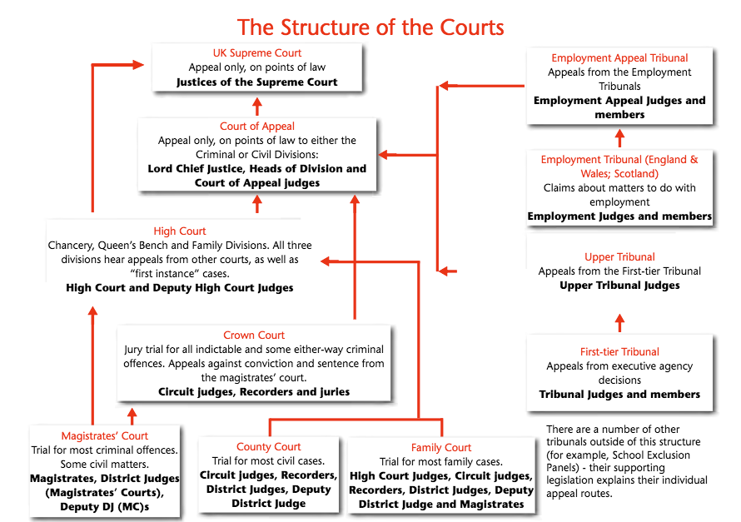

Slide 7
In England and Wales, most civil cases are heard in the County Court. Many specialist tribunals have been created to resolve particular types of civil disputes, such as those involving taxation and employment, as well as immigration and asylum cases. All criminal cases originate in the Magistrates' Court, but more serious offenses are referred to the Crown Court.

Slide 8
The High Court functions as both a court of first instance for high value civil claims and as an appellate court for civil and criminal cases. It consists of three divisions: the Queen's Bench, the Chancery Division, and the Family Division.

Slide 9
The Court of Appeal functions solely as an appellate chamber. The Civil Division hears appeals form the High Court and the County Court, and the Criminal Division hears appeals from the Crown Court.

Slide 10
The Supreme Court
The Constitutional Reform Act 2005 made provision for the creation of a new Supreme Court for the United Kingdom.
There had, in recent years, been mounting calls for the creation of a new free-standing Supreme Court separating the highest appeal court from the second house of Parliament, and removing the Lords of Appeal in Ordinary from the legislature. On 12 June 2003 the Government announced its intention to do so.
Before the Supreme Court was created, the 12 most senior judges – the Lords of Appeal in Ordinary, or Law Lords as they were often called – sat in the House of Lords.
The House of Lords was the highest court in the land – the supreme court of appeal. It acted as the final court on points of law for the whole of the United Kingdom in civil cases and for England, Wales and Northern Ireland in criminal cases. Its decisions bound all courts below.

Slide 11
The creation of a new Supreme Court means that the most senior judges are now entirely separate from the Parliamentary process.
It is important to be aware that the new Supreme Court is a United Kingdom body, legally separate from the England and Wales courts as it is also the Supreme Court of both Scotland and Northern Ireland. As such, it falls outside of the remit of the Lord Chief Justice of England and Wales in his role as head of the judiciary of England and Wales.
The new Supreme Court opened for business in October 2009, at the start of the legal year.

Slide 12


